Slide 1

Scalable Library Management System
Sravani Banala

Slide 2

Table of Contents
Design & Analysis
Problem Statement
01
02
Implementation
03
04
Big learnings

Slide 3
01
Problem Statement
Problems with maintenance and care have existed from the beginning of time
Most libraries give readers the impression that they are highly disorganized in the absence of a good system
Maintaining and preserving historical records and materials requires great care
The problem we are trying to solve is the management system in a library

Slide 4
The Idea
Library is a collection of different types of books and provides books for large number of readers. Thus, we need a software for managing the Library.
A library management system allows for the organised handling of book records and book readers
The primary objective of library Management system is to handle entire activity of library electronically
Library Management System is built using Java, JavaFX which Mainly focuses on basic operations in a library like adding new students, new books, searching books to issue and return books

Slide 5
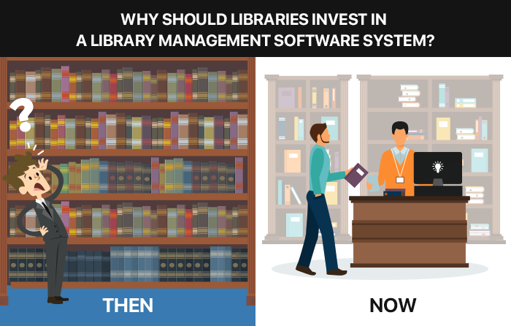
It provides better and efficient service to students with huge collection of textbooks
It helps both students and librarian to keep constant track on books available in library and books issued to students.
All details will be available on a click for both user and librarian

Slide 6
Design & Analysis
02
We implemented the project using Java concept, JavaFX
Tools such as scene builder, MySQL workbench were used to create the UI and manage the data
We maintained our progress on Trello and used google drive to store all the documents so all of us can access them
We pushed the source code to a git repository

Slide 7
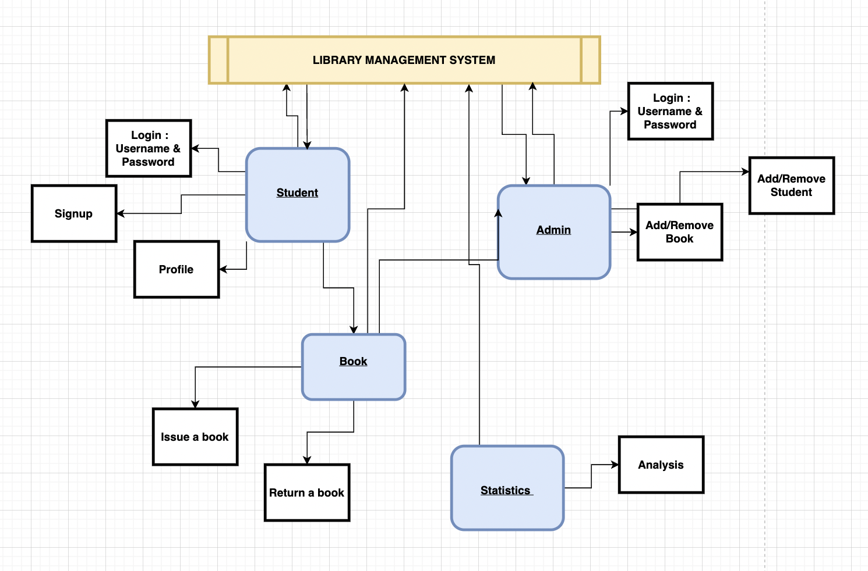
Use cases and interactions in our design

Slide 8
Design &Analysis
Our project was designed using two use-cases:
1. Admin
2. User/Student
The Librarian/Admin gets the same interface as the User/Student wherein they can login into their respective dashboards using their Username and Password. In case of a librarian, he/she can add/remove a student as well as books based on their availability
A Student/User can access their profile by logging in or signup to be a member of said library
The book is a commodity that can be issued or returned and, in the UI, has an impact on most use cases

Slide 9
Implementation
03
Student
Admin
Login
Signup
Profile
Login
Add/Remove -Student, Books
Issue/Return
Books
Statistics
Analysis
Issue
Return

Slide 10
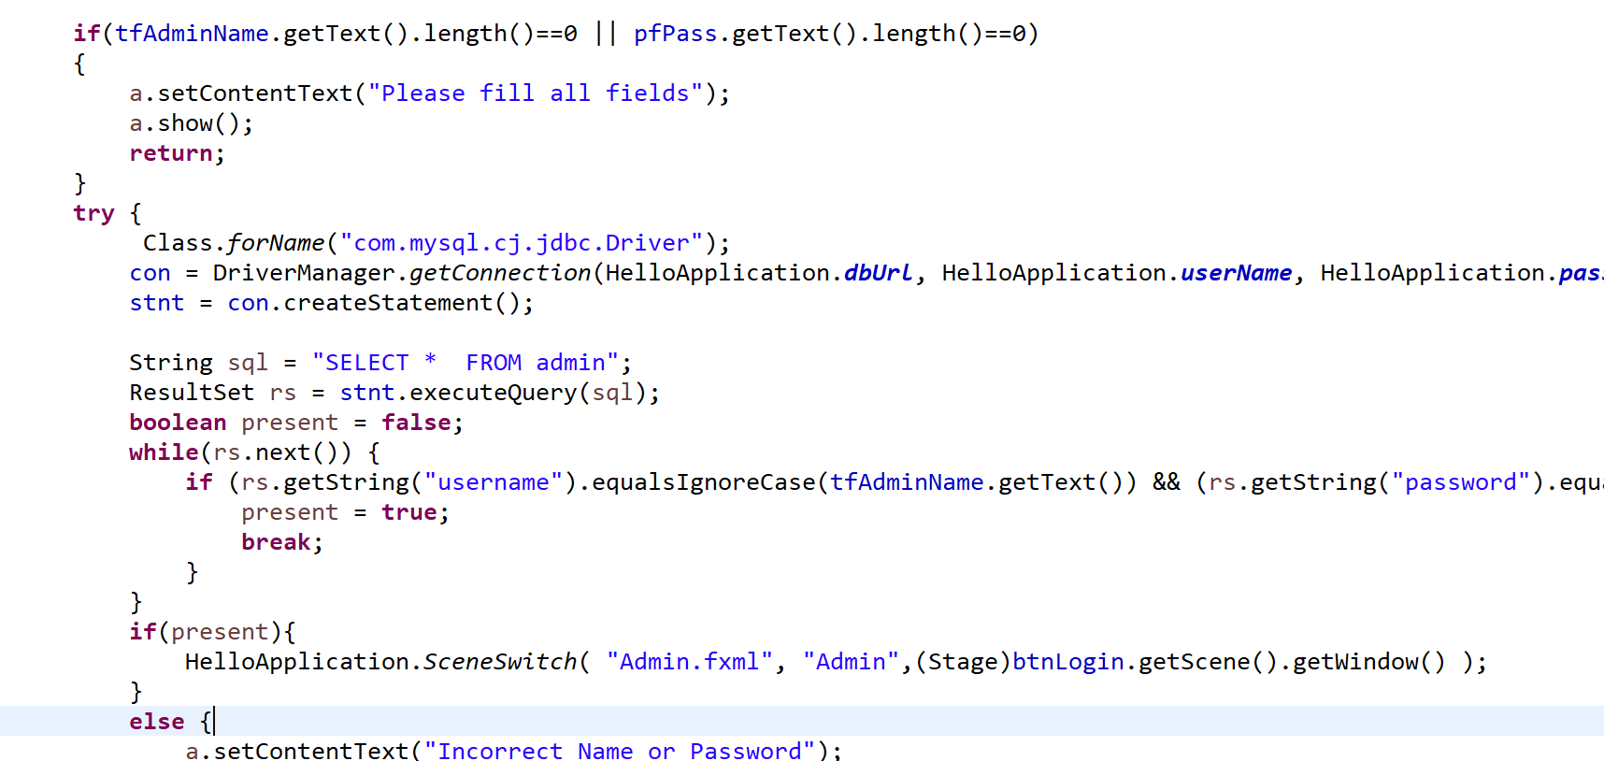
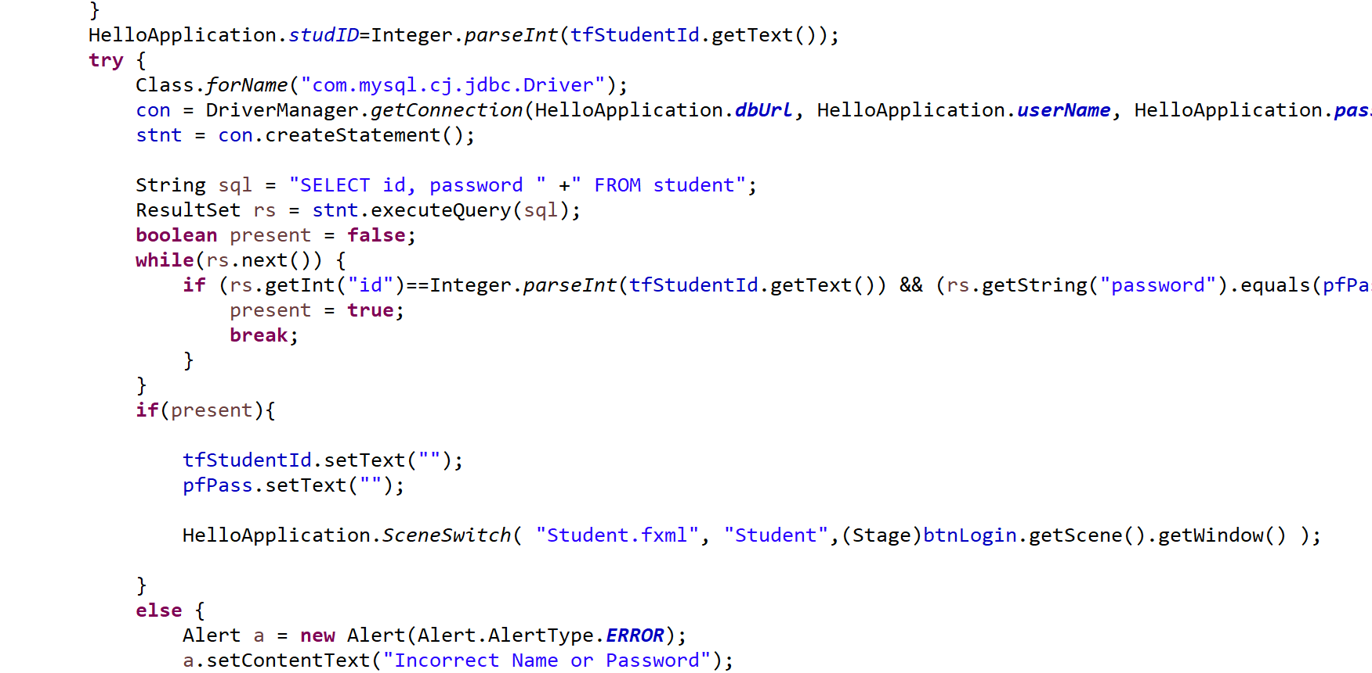
LOGIN
Student/Admin Login
There are two buttons: one is for Admin login and the other is for Students
Requesting User to input their Student id and Password in the same way they did on the signup page, before login checking whether the user has filled out all the boxes on the student login page, if not asking user to enter all the fields, then switch to the Student.fxml page if the information was entered correctly
Similarly, Admin enters Admin's Name and Password; if entered correctly, Admin.fxml is switched to.
For the Student Signup page we have name of the student, father's name, date of birth, email, which course student is into. After entering all the details request goes to admin from addstudent database, for the approval and admin sees the details and approves the student and inserts the data into student database

Slide 11
ISSUE/RETURN BOOKS
Student Requesting Book :
In the student issueBook.fxml we see the status of the books as if the book is issued, no issuable, requested, then the student requests the book and send the information the admin to issue the book. Here the student requests the book from book database then sends the requests to the admin using issue book database inserting the values for studentid, bookid, bookname, studentname to the admin to grant the access.
Admin Issuing Book :
Here the Admin gets the request from the user and access it out in AdminIssueBookController, to issue the book admin needs to add the issuedate, duedate and then issue the book, while issuing the book the request needs to be deleted an updated to issued from book database as issued and delete the request from issue book
In the same way if the admin wants to cancel the request of user, updates the status of book as issuable again and deletes the request from the issue book
All the above is viewed on the AdminIssueBook.fxml by using showIssueBook Action

Slide 12
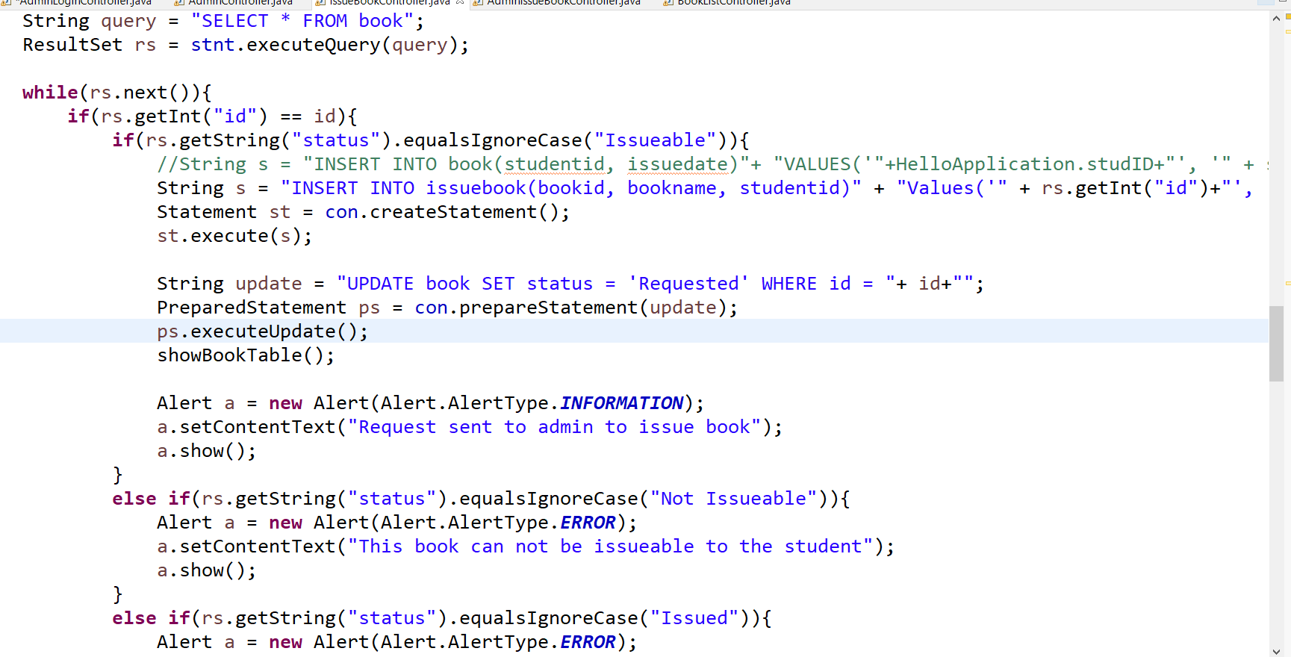
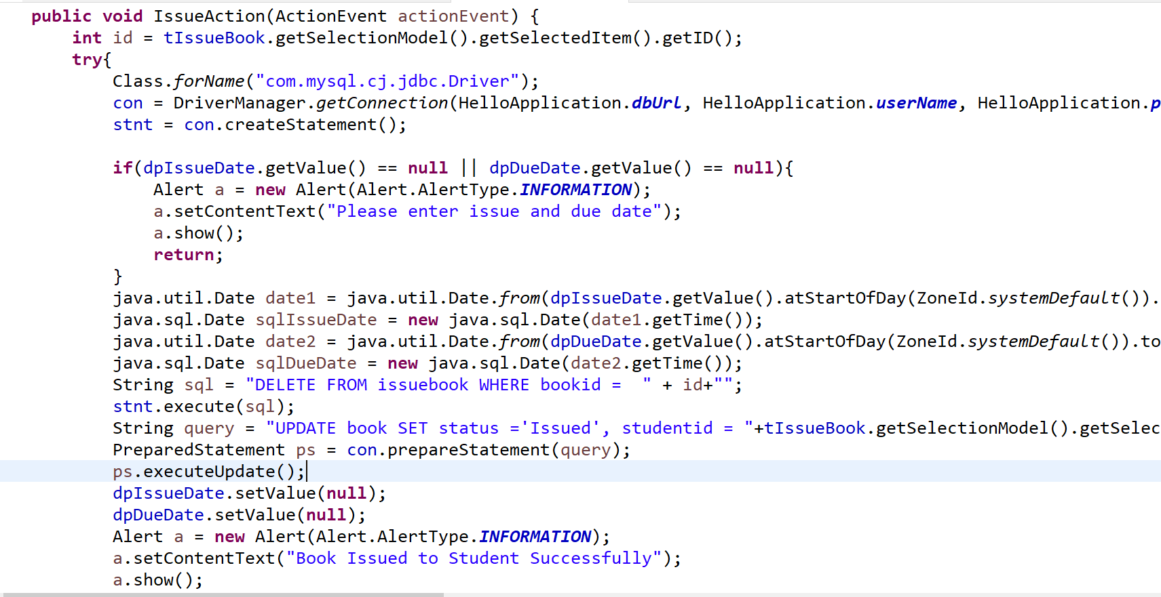
ISSUE/RETURN BOOKS
Student Requesting Book
Admin Issuing Book

Slide 13
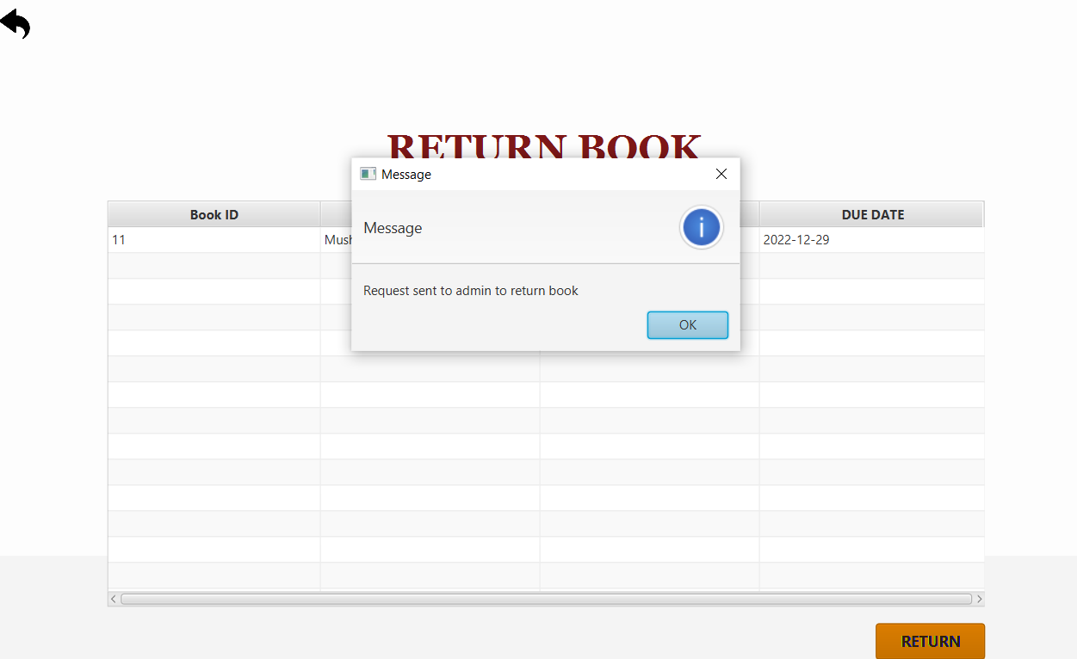
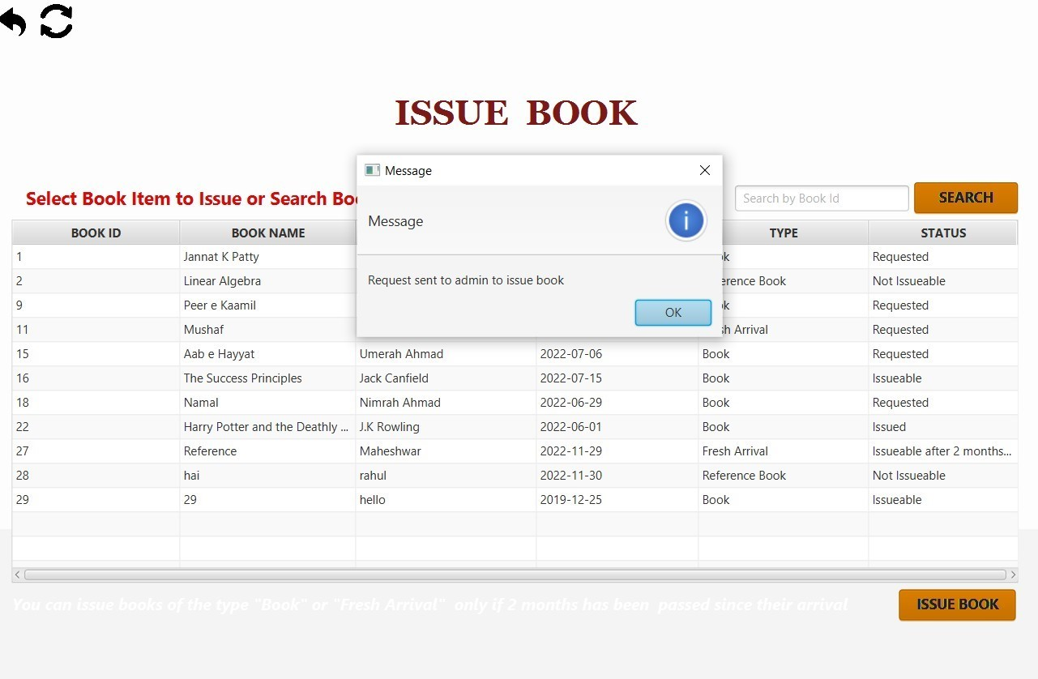

Slide 14
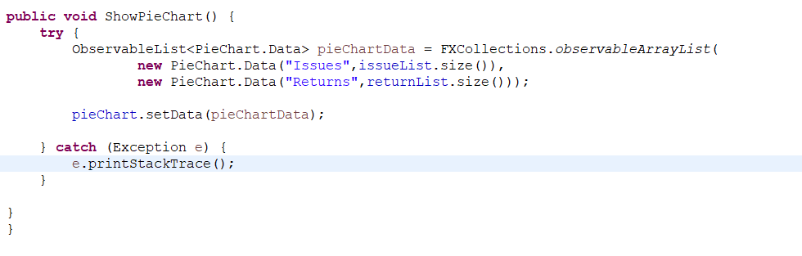
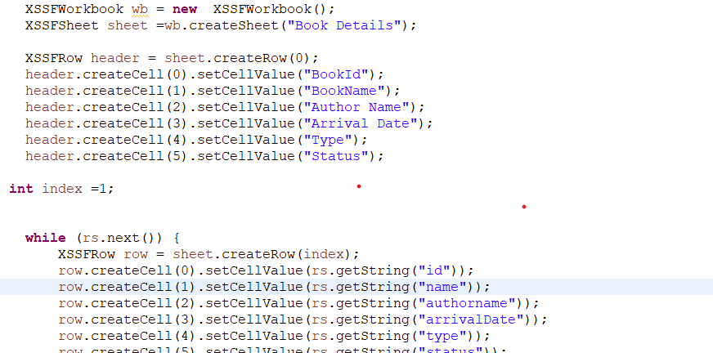
STATISTICS
In statistics screen Admin can get detailed view of issue book and return book details
We have also implemented the pictorial representation of issue and Return books using through
We have implemented the Export To Excel for Analysing the book Details

Slide 15
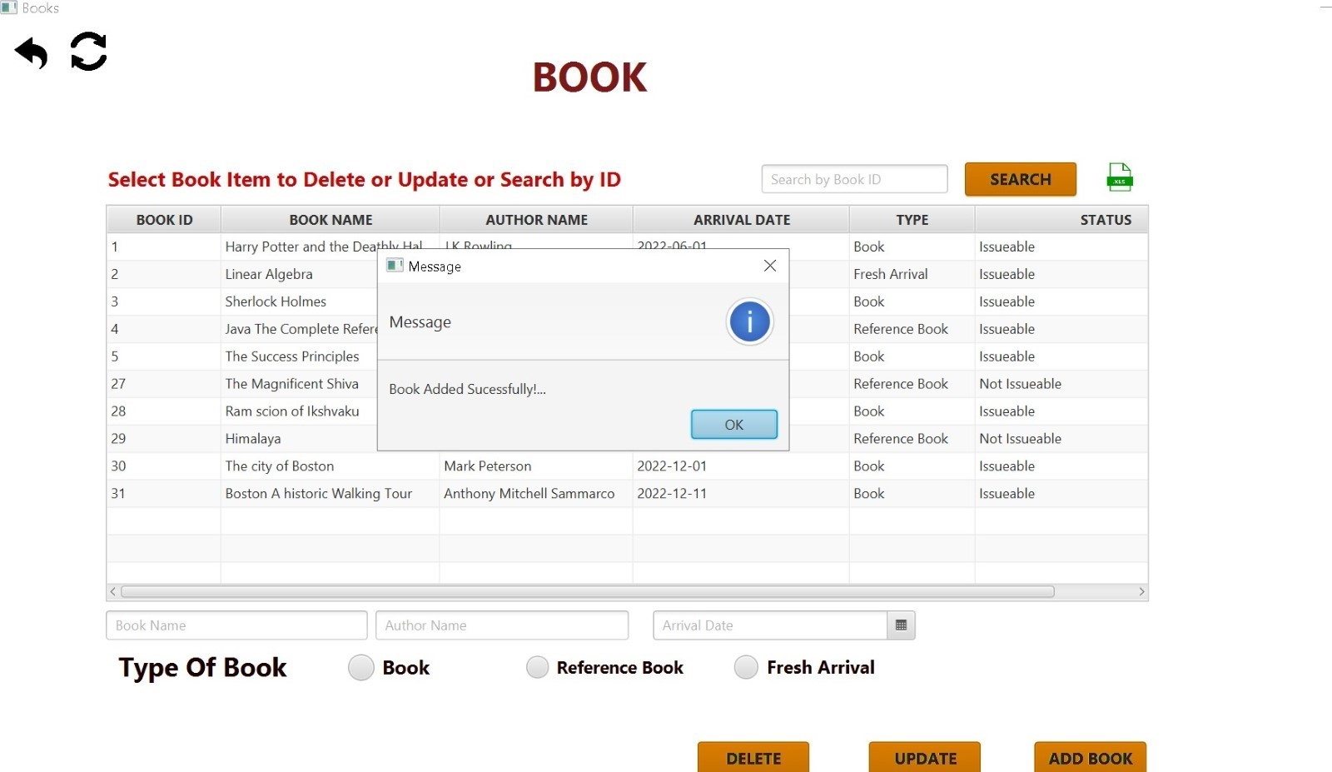
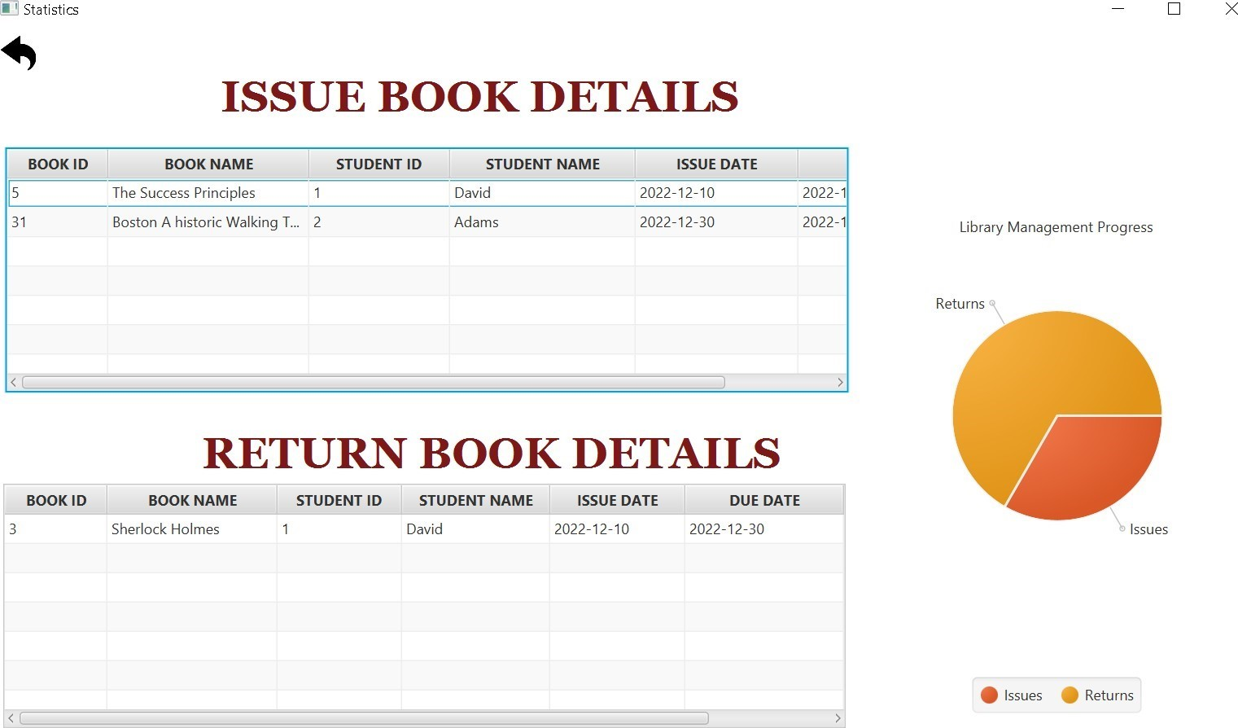

Slide 16

DEMO

Slide 17
Big Learnings
04
Design and UML Diagrams for Admin and student
Collections ,Event driven Programming, Integrating with database
Time Management
Statistical Integration

Slide 18

Any questions?
Thank you for your time! ☺

